Slide 1

6th Grade Math
Unit 5, Lesson 2 Plotting on the Coordinate Plane Volume 1, pg. 208

Slide 2



Benchmark
MA.6.GR.1.1
Extend previous understanding of the coordinate plane to plot rational number ordered pairs in all four quadrants and on both axes. Identify the $x$- or $y$-axis as the line of reflection when two ordered pairs have an opposite $x$- and $y$-coordinate.
volume 1, pg. 208

Slide 3
Integrated Mathematical Thinking and Reasoning Standards
MA.K12.MTR.1.1 Actively participate in effortful learning both individually and collectively.
MA.K12.MTR.4.1 Engage in discussions that reflect on the mathematical thinking of self and others.
MA.K12.MTR.5.1 Use patterns and structure to help understand and connect mathematical concepts.
MA.K12.MTR.6.1 Assess the reasonableness of solutions.
MA.K12.MTR.7.1 Apply mathematics to real-world contexts.
volume 1, pg. 208

Slide 4

Learning Targets
I can plot rational ordered pairs.
I can plot integers using different scales.
volume 1, pg. 208

Slide 5

Warm-Up
volume 1, pg. 208

Slide 6
5.2.1 Warm-Up: Interior Designer
After getting a degree in graphic design, Soledad Alzaga built her career and company as an interior designer. Interior designers make interior spaces functional, safe, and beautiful by determining space requirements and selecting decorative items such as colors, lighting, and materials. Beyond being creative and having good taste, Soledad says to own a successful interior design business, it is necessary to have the ability to work and communicate with others, be organized, have business knowledge, and to have math and measurement skills.
volume 1, pg. 208

Slide 7
What is something that interests you that you would like to spend your career doing?
What skills do you think are needed to be successful in that career?
volume 1, pg. 208

Slide 8

Refresher
volume 1, pg. 209

Slide 9


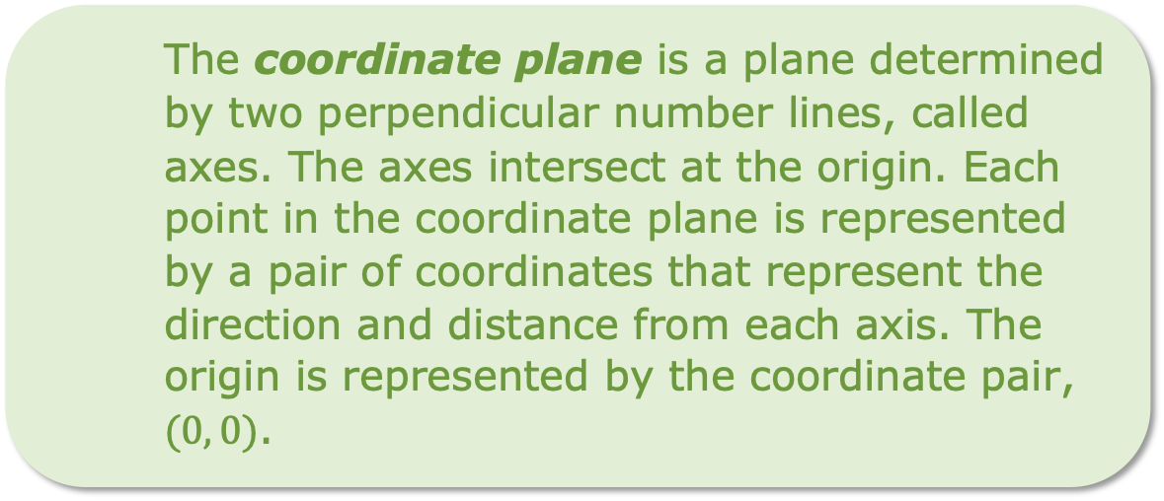
5.2.2 Refresher: Key Terms with the Coordinate Plane
Several key terms related to the coordinate plane were used throughout Lesson 1. Below, you can find definitions for each of these key terms.
The coordinate plane is a plane determined by two perpendicular number lines, called axes. The axes intersect at the origin. Each point in the coordinate plane is represented by a pair of coordinates that represent the direction and distance from each axis. The origin is represented by the coordinate pair, $(0, 0)$.
volume 1, pg. 209

Slide 10

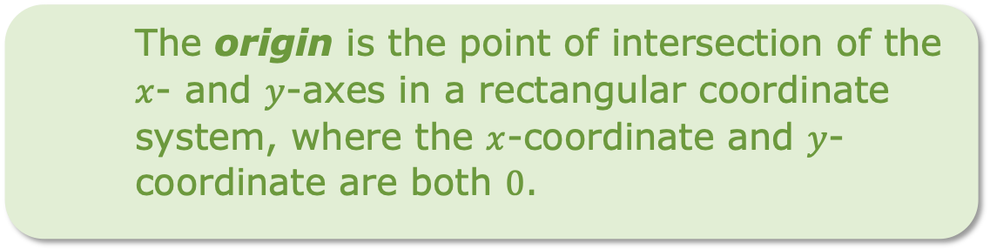
The axes of a graph are the horizontal and vertical number lines used in a coordinate plane system.
A coordinate is a number used to locate a point on a number line. A coordinate is one of the numbers in an ordered pair that locates a point on a coordinate plane.
The origin is the point of intersection of the $x$- and $y$-axes in a rectangular coordinate system, where the $x$-coordinate and $y$-coordinate are both $0$.
A quadrant is any of the four regions separated by the axes in a coordinate plane.
volume 1, pg. 209

Slide 11

Exploration
volume 1, pg. 209

Slide 12

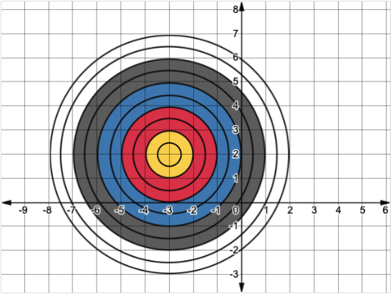
5.2.3 Exploration: Plotting Ordered Pairs
Two players engage in a game of darts.
volume 1, pg. 209

Slide 13
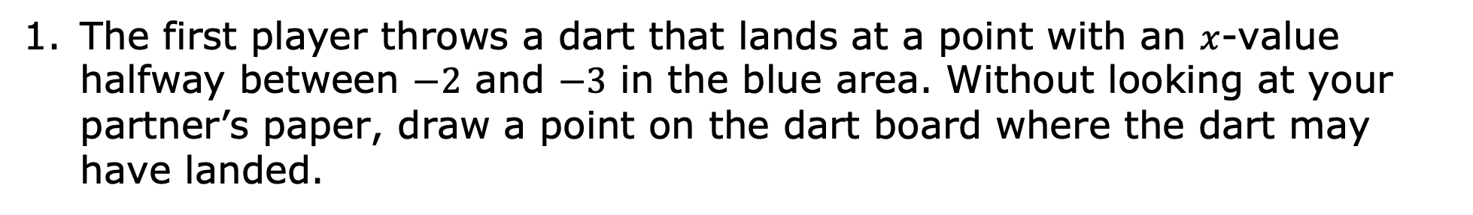
The first player throws a dart that lands at a point with an $x$-value halfway between $−2$ and $−3$ in the blue area. Without looking at your partner’s paper, draw a point on the dart board where the dart may have landed.
What are the approximate coordinates of the dart?
What are the approximate coordinates of your partner’s dart?
volume 1, pg. 209

Slide 14
The second player throws a dart that lands in the red area, but not on one of the black circles. Without looking at your partner’s paper, draw a point on the dart board where the dart may have landed.
What are the approximate coordinates of the dart?
What are the approximate coordinates of your partner’s dart?
volume 1, pg. 210

Slide 15





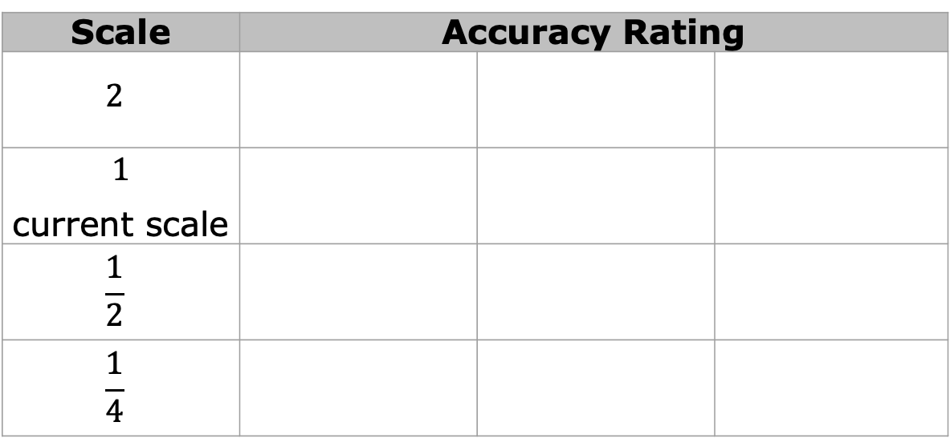
The scale used on the grid is 1 unit. Discuss with your partner how the scale used on the grid could be changed to make coordinates of the darts more accurate. Give each scale in the table a rating by circling the face that best describes the scale’s accuracy, where means the location of the coordinates would not be very accurate, and means the location of the coordinates would be very accurate.
Scale | Accuracy Rating
$$2$$
$$1$$ current scale
$$\frac{1}{2}$$
$$\frac{1}{4}$$
volume 1, pg. 210

Slide 16

Guided Practice
volume 1, pg. 210

Slide 17

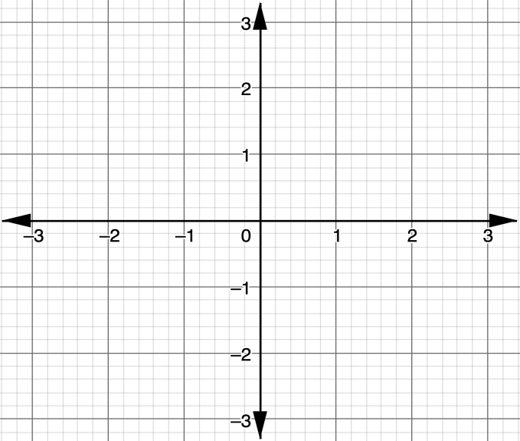
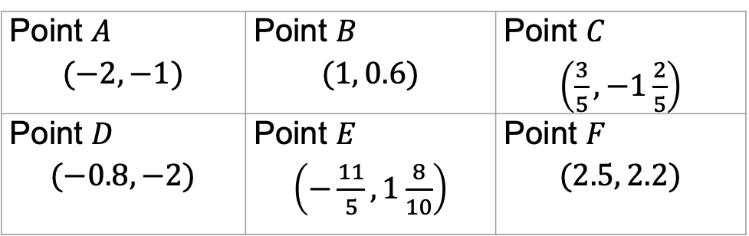
5.2.4 Guided Practice: Plotting Rational Ordered Pairs
On the coordinate plane, plot and label the points given.
Point $A$ $$(−2, −1)$$ | Point $B$ $$(1, 0.6)$$ | Point $C$ $\left(\frac{3}{5}, −1\frac{2}{5}\right)$
Point $D$ $$(−0.8, −2)$$ | Point $E$ $\left(−\frac{11}{5}, 1\frac{8}{10}\right)$ | Point $F$ $$(2.5, 2.2)$$
volume 1, pg. 210

Slide 18

Guided Instruction
volume 1, pg. 211

Slide 19
5.2.5 Guided Instruction: Choosing the Right Scale
When representing data, the scale of the grid is important to effectively and accurately communicate information.
A scale is the numeric values, set at fixed intervals, assigned to the axes of a graph.
volume 1, pg. 211

Slide 20
The table shows the total Florida tourism industry employees, in thousands, for years since 2002.
Years Since 2002 | Total Tourism Industry Employees (in thousands)
1 | 889.9
4 | 909.7
5 | 916.3
7 | 929.5
volume 1, pg. 211

Slide 21
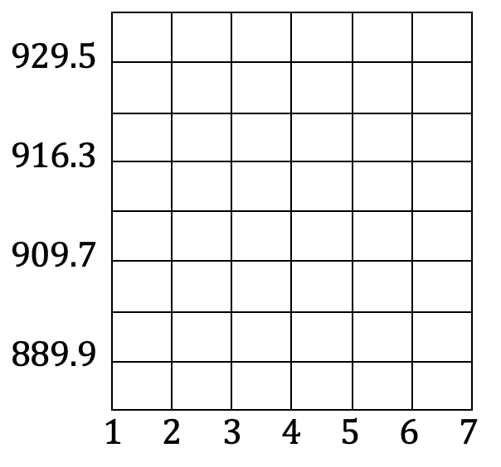
To plot the data, Andrea drew the coordinate grid shown.
Discuss with your partner why Andrea’s coordinate grid would not effectively nor accurately communicate the information about Florida tourism industry employees.
volume 1, pg. 211
1 2 3 4 5 6 7

Slide 22
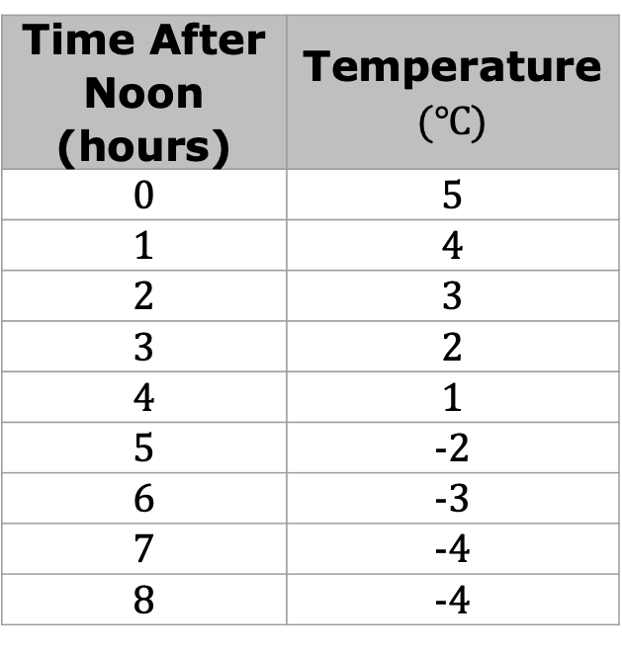
The data shown in the table are average autumn temperatures, in degrees Celsius $\left(℃\right),$ in Carmathen, Wales.
Time After Noon (hours) | Temperature $(℃)$
0 | 5
1 | 4
2 | 3
3 | 2
4 | 1
5 | -2
6 | -3
7 | -4
8 | -4
volume 1, pg. 211

Slide 23
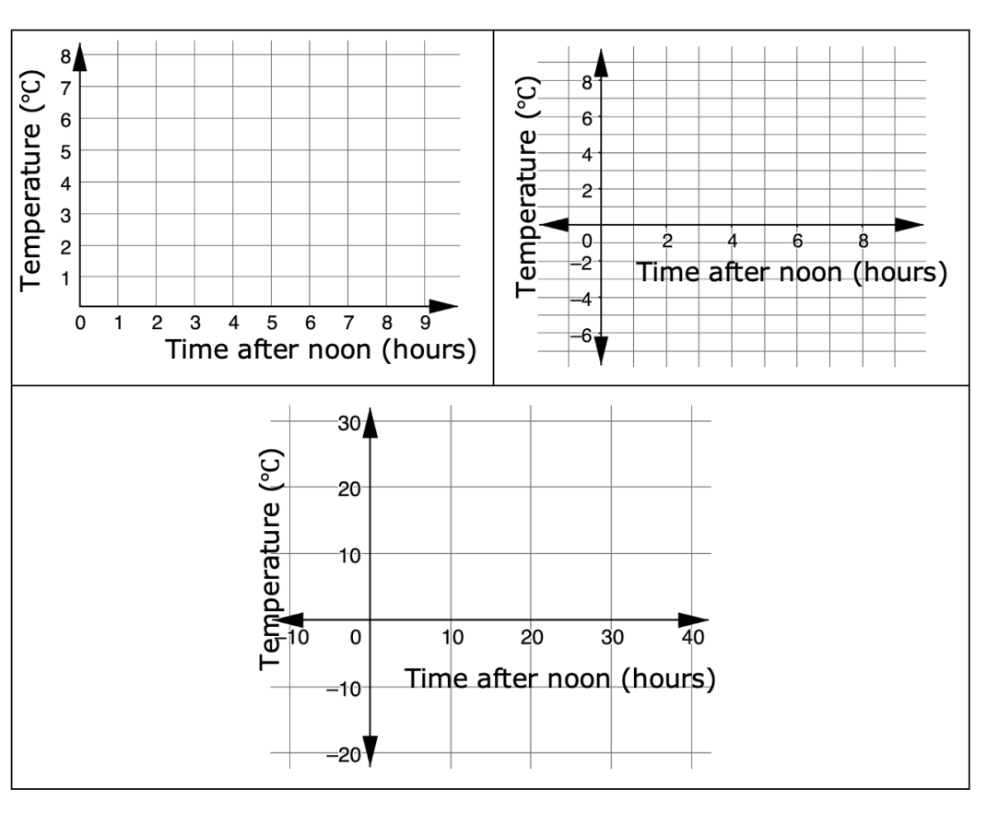
Three coordinate grids are shown, each using different scales.
volume 1, pg. 211

Slide 24
Explain which coordinate grid most accurately represents the data.
Explain why the other two coordinate grids may not be as accurate.
volume 1, pg. 212

Slide 25
When creating an appropriate graph, it is helpful to consider the following.
Determine which quadrants are needed by identifying the smallest and largest points of each variable.
Use these values to determine a good scale for the axis that represents the variable.
Then, determine the best scale for the grid lines by considering the numbers presented in the data.
Remember that the scale for each axis can be different, but that each axis must have a consistent scale.
volume 1, pg. 212

Slide 26

Four coordinates are given.
$$\left(1, 2\frac{1}{2}\right) \left(3\frac{1}{2}, −4\right) \left(−5, −2\right) (0, 3)$$
What is the smallest $x$-coordinate?
What is the largest $x$-coordinate?
What is the smallest $y$-coordinate?
volume 1, pg. 212

Slide 27
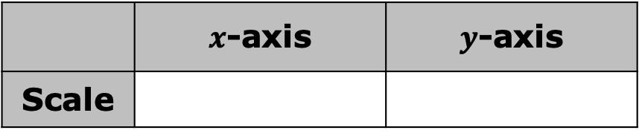
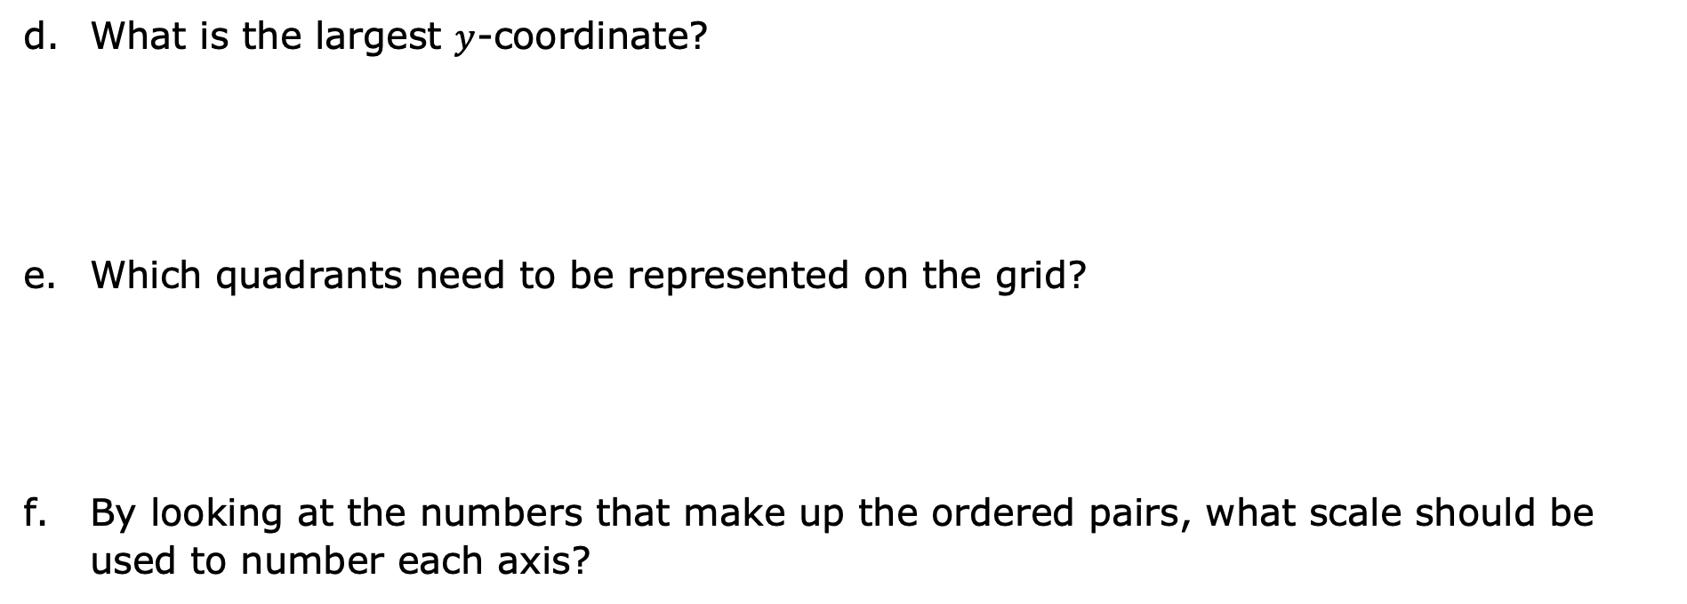
What is the largest $y$-coordinate?
Which quadrants need to be represented on the grid?
By looking at the numbers that make up the ordered pairs, what scale should be used to number each axis?
 | $x$-axis | $y$-axis
Scale
volume 1, pg. 212

Slide 28
On the grid, draw and label coordinate axes with an appropriate scale, and plot the points.
volume 1, pg. 213

Slide 29

Collaboration
volume 1, pg. 213

Slide 30

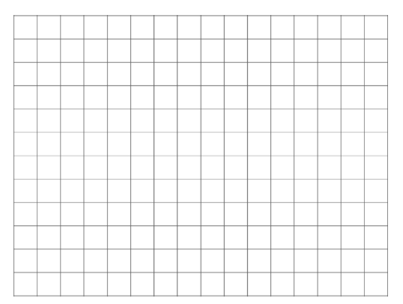
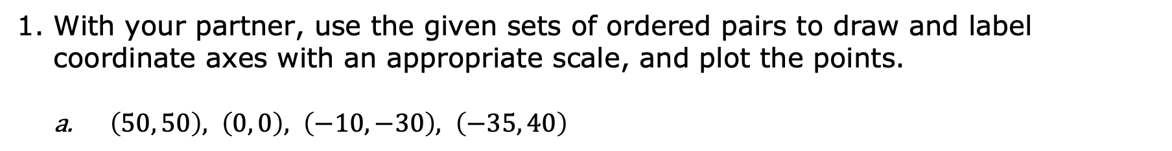
5.2.6 Collaboration: Choosing the Right Scale
With your partner, use the given sets of ordered pairs to draw and label coordinate axes with an appropriate scale, and plot the points.
$\left(50, 50\right), \left(0, 0\right), \left(−10, −30\right), \left(−35, 40\right)$
volume 1, pg. 213

Slide 31
$\left(\frac{1}{5}, \frac{4}{5}\right), \left(\frac{−3}{5}, \frac{2}{5}\right), \left(−1\frac{1}{5}, \frac{−4}{5}\right), \left(\frac{1}{5}, \frac{−3}{5}\right)$
volume 1, pg. 214

Slide 32
Find another group of partners to compare your graphs with. Explain what is the same and different between your graphs and their graphs.
If your graphs were different, were both still correct representations of the ordered pairs?
volume 1, pg. 214

Slide 33

Wrap-Up
volume 1, pg. 214

Slide 34
5.2.7 Wrap-Up: Ticket Out the Door
When plotting $\left(−3.5, 40\right)$ and $(4, −60)$, describe how you would scale the axes.
volume 1, pg. 214

Slide 35

For the points $\left(−3.5, 40\right)$ and $(4, −60)$, draw and label coordinate axes with an appropriate scale, and plot the points.
volume 1, pg. 214

